Slide 1
FY26 Budget Finalization Meeting

Slide 2
Agenda
Action Items
Approval of Agenda
Approval of Previous Minutes
Final Budget Recommendation (after final presentation/review and discussion)
Discussion Items Presentation of the final budget recommendation
ACTION ITEM: GO Team vote on
Budget Information Items
Principal’s Report
CAT Report: February 24, 2025 Meeting
Committee Reports
Announcements
Public Comment

Slide 3
Norms
This is a meeting of the GO Team. Only members of the team may participate in the discussion. Any members of the public present are here to quietly observe.
We will follow the agenda as noticed to the public and stay on task.
We invite and welcome contributions of every member and listen to each other.
We will respect all ideas and assume good intentions.

Slide 4
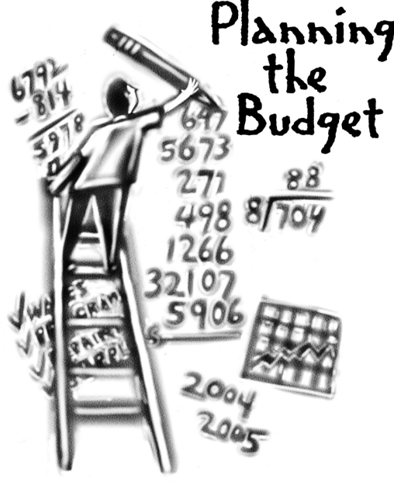
Overview of FY 26
GO Team Budget Process
Step 2 Principals Workshop FY 26 Budget
January 15
Step 4 Principals Cluster Supt. Discussions
Step 1 Update Strategic Plan & Rank Priorities
Step 7 Principals HR Staffing Conferences Begin
Feb. 24-27
Step 3 GO Team Initial Budget Session
January 15-31
Step 8* GO Team Budget Finalization Meeting
Budgets Approved by March 14
Step 6 Cluster Supt. Review February 17-21
Step 5* GO Team Feedback Mtg. February 10-14
GO Teams are encouraged to have ongoing conversations
* GO Teams will need to take ACTION on the budget at these meetings.

Slide 5
Budget Finalization Meeting
What
During this meeting GO Teams will review all components of the budget, which should be updated based on feedback from the Cluster Superintendent and key leaders. After review, GO Teams will take action (i.e., vote) on the FY26 Budget.
Why
Principals will present the final budget recommendations for GO Team approval.
When
All approval meetings must be held after staffing conferences. Budgets must be approved by March 14th.

Slide 6
Budget Updates

Slide 7
Changes since Feedback Meeting
There were not any changes made to the draft budget we discussed at our last meeting.

Slide 8
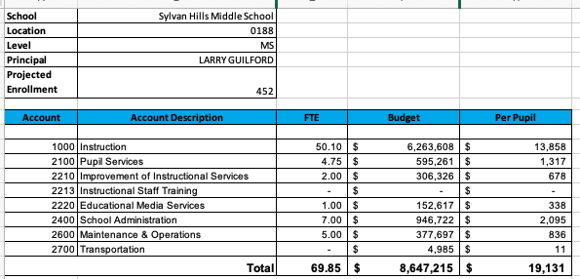
Budget by Function (required)
*Based on Current Allocation of School Budget

Slide 9
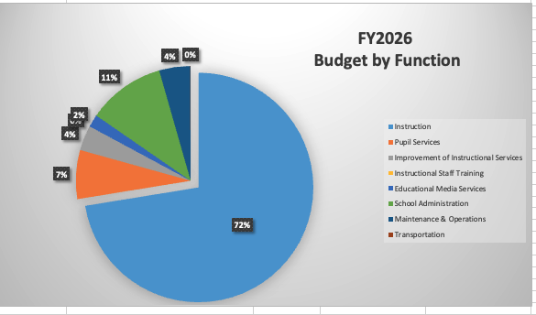
Budget by Function (required)
*Based on Current Allocation of School Budget

Slide 10
Discussion & Questions

Slide 11
Action on the Budget
The GO Team needs to TAKE ACTION (vote) on its FY26 budget.
After the motion and a second, the GO Team may have additional discussion.
Once discussion is concluded, the GO Team will vote.

Slide 12
Additional Agenda Items
Information Items
Principal’s Report
CAT Report: February 24, 2025 Meeting
Committee Reports
Announcements
Public Comment

Slide 13
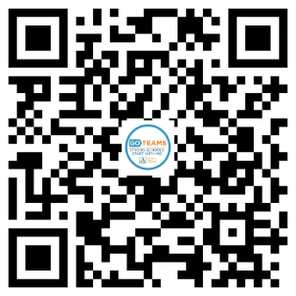
EXTENDED - declare by March 7!
tinyAPS.com/?2025GOTeamDeclaration

Slide 14
Thank you!

Slide 15
Appendix
FY26 Feedback Presentation

Slide 16
Principals
To ensure transparency, consistency, and clarity for stakeholders, please COPY your Budget Feedback Presentation into this appendix using one of the following methods:
Option 1
Copy Your Budget Feedback Presentation into This Template
Open your Budget Feedback presentation in PowerPoint.
Click on the first slide in the left panel of the Feedback Presentation.
Select all the Feedback Presentation slides (Ctrl+A/Cmd+A to select all slides).
Right-click and choose Copy.
Click after this slide (you’ll see a red bar in the left pane)
Right-click and select Paste. Choose Keep Source Formatting to maintain formatting.
Option 2
Add These Slides to the Front of your Budget Feedback Presentation
Open your Budget Feedback presentation in PowerPoint and Save a Copy (File/Save a Copy). This will become your Finalization Presentation.
Click on the first slide in the left panel of this presentation.
Select all the Finalization Presentation slides (Ctrl+A/Cmd+A to select all slides).
Right-click and choose Copy.
Open the Copy of your Feedback Presentation and Click before the first slide (you’ll see a red bar in the left pane)
Right-click and select Paste. Choose Keep Source Formatting to maintain formatting.

